Slide 1
Cytokines and Acute Phase Proteins
Dr. Nadisha Badanasinghe
MBBS, Dip/Med.Micro, MD
Lecturer/ Dept. of Medical Microbiology

Slide 2
Objectives
Cytokines
Introduction
Nomenclature
Functions
Clinical implications
Acute phase proteins
Acute phase reaction
Functions
Clinical implications

Slide 3
Cytokines
A group of small proteins
Act as mediators of innate and acquired immune system
Important in cell signalling and chemotaxis
Regulate the nature, intensity and duration of the immune response
Modulate the balance between humoral and cellular immune responses
Regulate the maturation, growth, and responsiveness of immune cells

Slide 4
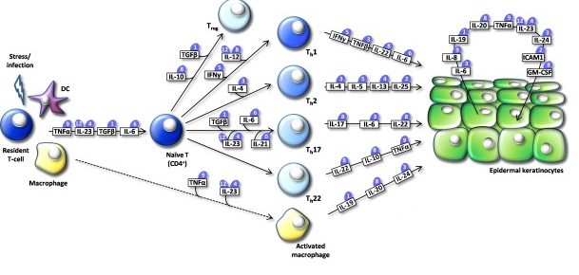

Slide 5
Cytokines- Nomenclature In Greek – “cyto” = cell “ kinos” = movement
Cytokines produced by lymphocytes
“Lymphokines”
Cytokines produced by monocytes
“Monokines”
Cytokines produced by leukocytes to communicate
“Interleukins”
Cytokines important for chemotaxis
“chemokine”
Not exclusively a product of one cell type - better terminology- Cytokines
Word Cytokine encompasses all above terminology

Slide 6
General properties
Production is regulated by immediate stimuli
Half-life is short (minutes to hours)
Constitutive production is usually absent, or low
Secretion is brief and self-limiting
Cytokine receptors typically have an extremely high affinity to their ligand
One type of cytokine is produced by multiple cell types
One cytokine can act on different cell types (Pleiotropy)
Different cytokines act on the same type of cell (Redundancy)
One cytokine has multiple effects on one target cell
Many cytokines have similar actions (Synergy)
Often influence production of other cytokines (Cascade effect)

Slide 7
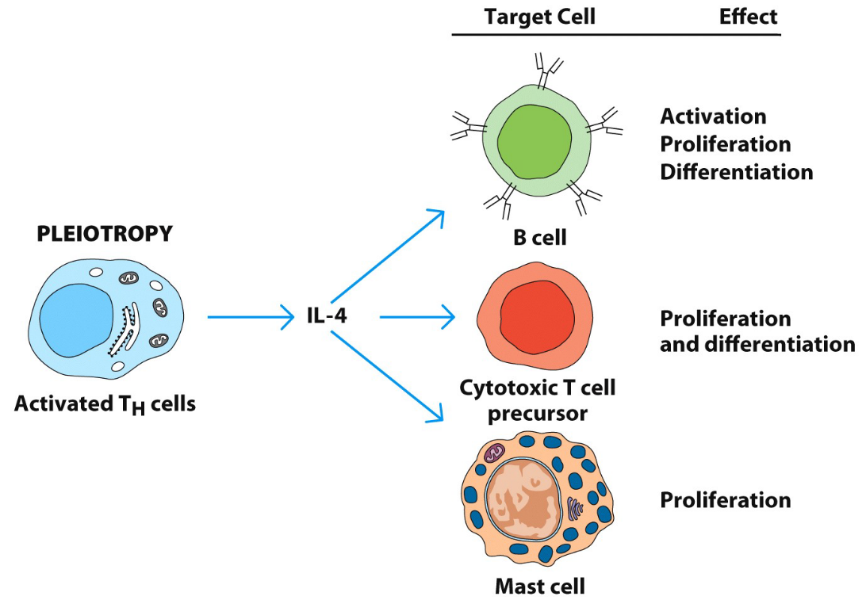
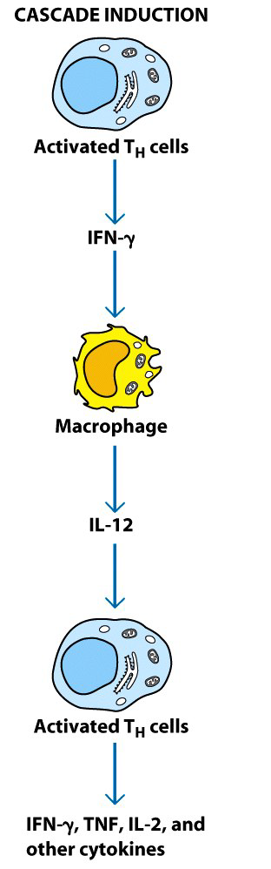
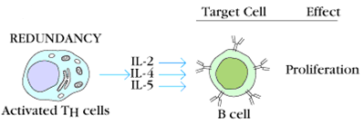
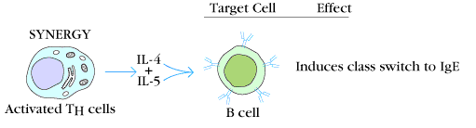

Slide 8
Cytokines
Depending on the site of action
Autocrine – act on same cell
Paracrine – act on neighboring cells
Endocrine – act on distant cells
Depending on their function – 3 groups
Mediation and regulation of innate immune response
Mediation and regulation of acquired immune response
Stimulation of growth and differentiation of immature cells
Cytokines which mediate inflammation and acute phase response
Pro-inflammatory cytokines
Anti-inflammatory cytokines

Slide 9
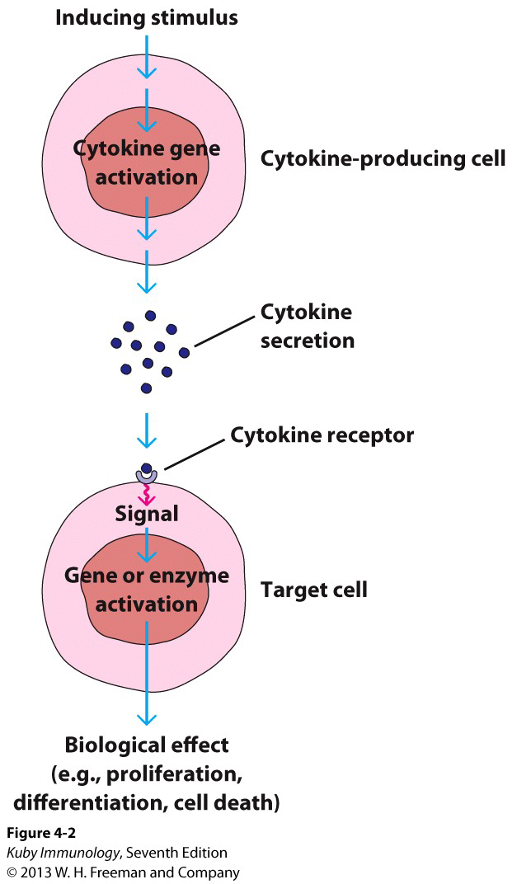

Slide 10
Inflammation and Acute phase response
Inflammation is an immunological defense mechanism of the body against injury and infection
Acute inflammatory response is characterized by rapid onset and is of short duration.
This is accompanied by a systemic response known as the acute phase response which is characterized by alterations in the levels of several plasma proteins
Inflammatory cells (Macs) → cytokines → act on fibroblast/ endothelial cells/ hepatocytes → APR

Slide 11
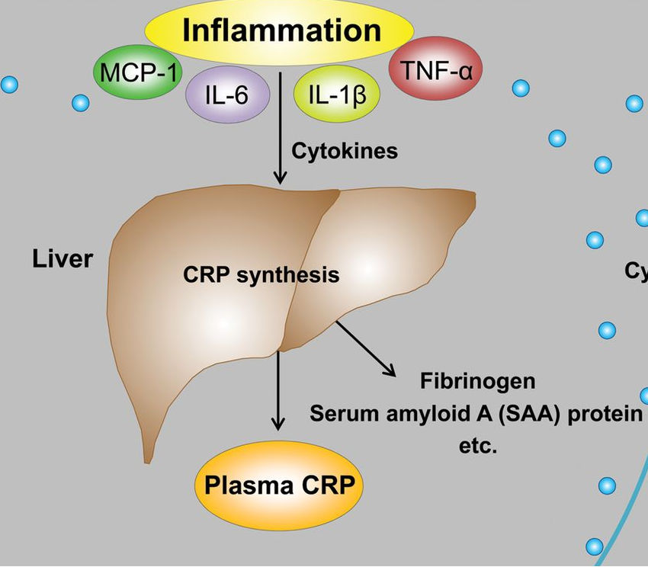

Slide 12
Pro-inflammatory cytokines
Promote inflammatory responses
Pro-inflammatory cytokines are produced predominantly by activated macrophages
IL-1β
IL-6
TNFά
IL-18
IL-33
IL-17

Slide 13
Anti-inflammatory cytokines
Cytokines that control the pro-inflammatory cytokine response
Act mainly by the inhibition of the production of pro-inflammatory cytokines or by counteracting many biological effects of pro-inflammatory mediators
IL4
IL10
IL-11
interleukin (IL)-1 receptor antagonist
IL13
IL35

Slide 14
Cytokines that mediate innate immunity
Type 1 interferons (IFN ά,IFN β)
Source - IFN ά – mononulear pghagocytes
IFN β – fibroblast cells
Functions
Inhibit viral replication - “ anti viral state”
Increase the action of NK cells
Increase the expression of MHC class 1 molecules
Important against viral infections

Slide 15
Cytokines in innate immunity
Tumour Necrosing Factor ά (TNFά)
Source – Mono Nuclear Phagocytes (MNP)
Functions
Low Conc. - Stimulates functions of MNP
High Conc. - Systemic effects
Endogenous pyrogen
Hepatocytes acute phase proteins
MNP further synthesis of IL 1, IL 6 (autocrine)
Promote coagulation
Suppress bone marrow cell division
Very high Conc. ( tissue injury, shock)
reduce myocardiac contractility , reduce tissue perfusion, reduce BP, IV thrombosis
Notes:
15

Slide 16
Cytokines that mediate innate immunity
3. Interleukin 1 (IL1)
Source – activated mono nuclear phagocytes
Functions – mediate host inflammatory response
At low levels – local inflammation
High levels – systemic effects
Endogenous pyrogen
Hepatocytes acute phase proteins
MNP further synthesis of IL 1, IL 6
Promote coagulation

Slide 17
Cytokines that mediate innate immunity
Interleukin 6 (IL6)
Source – MPN, Fibroblsts, endothelial cells
Functions
Hepatocytes acute phase proteins
Growth factor for activated B cells
Chemokines-Activate and direct effector cells to sites of tissue damage (IL-8)
Produced by activated macrophages
Act mainly on neutrophils stimulate mobility and motility mediates inflammation

Slide 18
Cytokines that mediate specific immunity
Important for viral infections and intra-cellular bacterial infections
Interferon γ ( IFN γ ) – type 2 IFN
Source - CD4 (TH1), CD8, NK cells
Functions
Induces an anti viral state
Activates macrophages fully to kill microbes
Increase the expression of MHC class 1 and MHC class ii molecules
Stimulates cytotoxic activity of NK cells
Act on T & B lymphocytes to promote differentiation

Slide 19
Cytokines that mediate specific immunity
IL 2
Source- CD 4 (Th1 subset), CD8 T cells
Functions
Stimulates T lymphocytes ( autocrine)
Stimulates NK cells
Stimulates B cells

Slide 20
Cytokines that mediate specific immunity
IL 4
Source – CD4 cells (Th 2 subset)
Functions
Promote production of IgE
B cell growth factor
Promote growth and differentiation of Th2 subset
TGF β – by activated T cells
Action - negative regulator of the immune response

Slide 21
Cytokine effects on Th1 and Th2 immune response
Th₀
+ +
- -
CTL and IgG Abs IgA and IgE Abs
IL₁₂
IFN γ
IL₄
IL₁₀
IL₄
IL₁₀
IL₁₂
IFN γ
Th1
Th2

Slide 22
Cytokines that stimulate growth and differentiation of immature cells
IL 3 – multi lineage colony stimulating factor
Granulocyte – Monocyte colony stimulating factor(GM-CSF)
Monocyte colony stimulating factor(M-CSF)
Granulocyte colony stimulating factor(G-CSF)

Slide 23
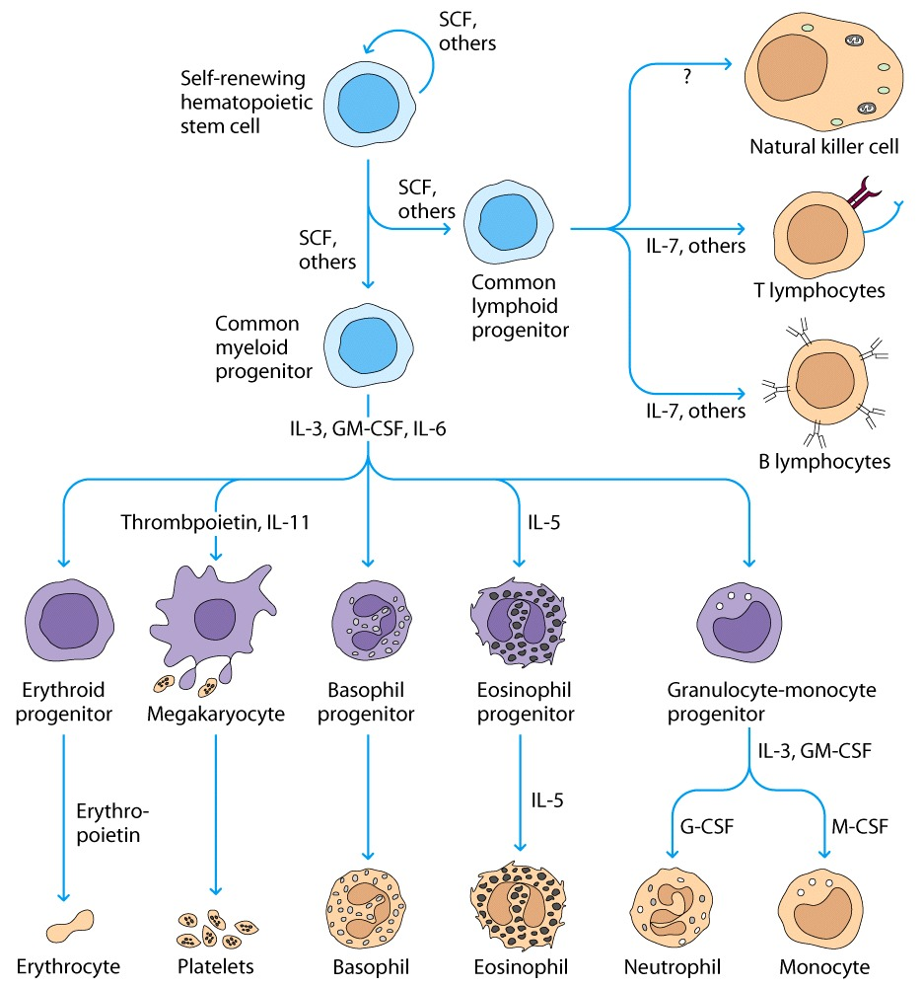

Slide 24
Cytokines in Acute Phase Response
TNFά, IL 1, IL 6
Called endogenous pyrogens
Most pathogens grow better at low temperature
Innate immune responses are better at high temperature
Important in inducing an acute phase response

Slide 25
Cytokine therapies
Interferons
IFN-α- certain types of tumors, as antivirals
IFN-β- multiple sclerosis, as antivirals
IFN-γ- chronic granulomatous disease
IL-2- certain types of cancer
Renal cell carcinoma
GM-CSF-
immune deficiencies, Rx of low granulocyte count

Slide 26
Acute Phase Proteins
Protiens that are synthesized by the liver in respons to acute inflammation
“ Acute Phase Reaction”
C- reactive protein (CRP)
Mannose- binding protein (MBP)
Alpha 1- antitrypsin
Alpha 2- macroglobulin
Coagulation factors
Complement factors
Serum amyloid P component
Ferritin
Cytokines which induce an APR are TNFά, IL 1, IL 6

Slide 28
Acute Phase Reaction
Tissue injury
local inflammatory cells( neutro, macs)
secrete cytokines ( IL-1, IL-6, IL-8,TNF alpha) into the blood stream
Liver
Secrete acute phase proteins

Slide 29
Acute Phase Reaction
IL-1, TNF alpha
Bone marrow endothelium
Neutrophil mobilization
Phagocytosis
IL-1, IL-6, TNF alpha
Hypothalamus
Temperature set point
Cause fever

Slide 30
Acute Phase Protiens
CRP
Icreaseed by >1000 folds in bacterial infections within 6-12 hours after infection
Functions
Opsonization of bacteria
Complement activation
Clinical importance
Early indicator of infection/ inflammation
Monitor the disease progression/ response to treatment

Slide 31
2. MBP
A soluble factor that binds to the mannose residues in pathogens
A part of innate immune defense against bacterial infections
Important immune response in newborns
Functions
Opsonization
Complement activation

Slide 32
Other Acute Phase Proteins
ά₁ antitrypsin-
Inactivate enzymes → limit the damage by activated cells
Inhibit inflammation
deficiency leads to pulmonary emphysema and liver cirrhosis
Pulmonary surfactant A, D
Opsonin
Prevent lung collapse
Fibrinogen
Thrombosis, vascular injury
Trapping microbes in blood clot
Serum amyloid A & P
Opsonin
Chemotaxis

Slide 33
Summary
Cytokines
Introduction
Nomenclature
Functions
Inflammation
APR
Clinical implications
Acute phase proteins
Acute phase reaction
Functions
Clinical implications
CRP

Slide 34
Thank you

